Slide 1
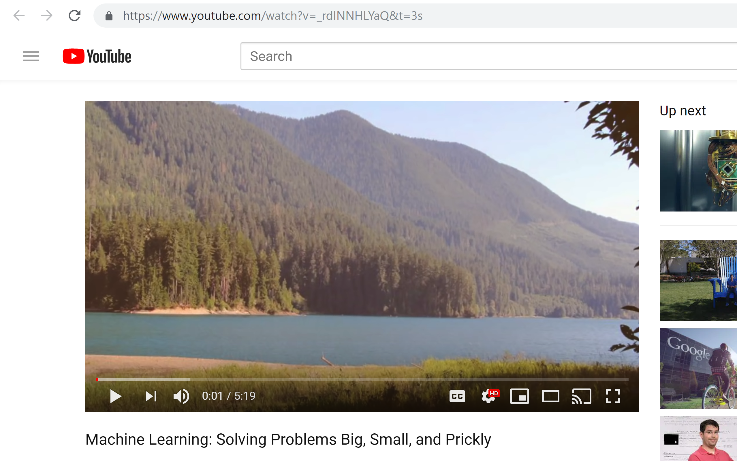
https://www.youtube.com/watch?v=_rdINNHLYaQ&t=3s

Slide 2
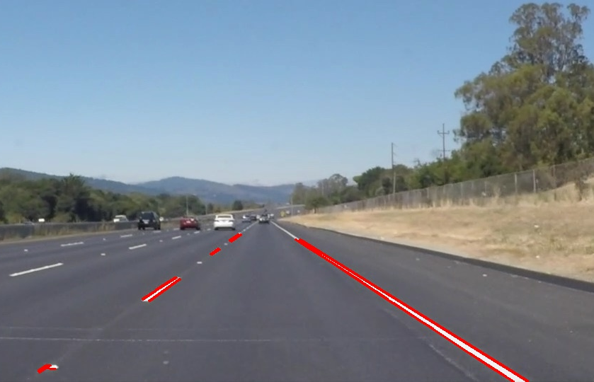
Finding lane lines

Slide 3
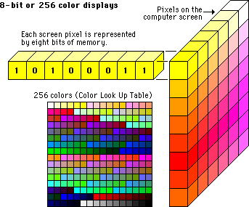
Represent colors by numbers

Slide 4
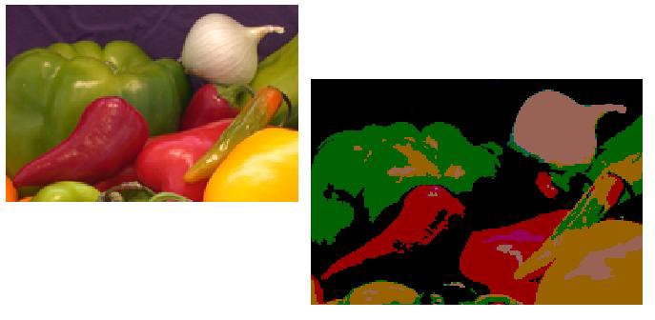
Image Segmentation

Slide 5
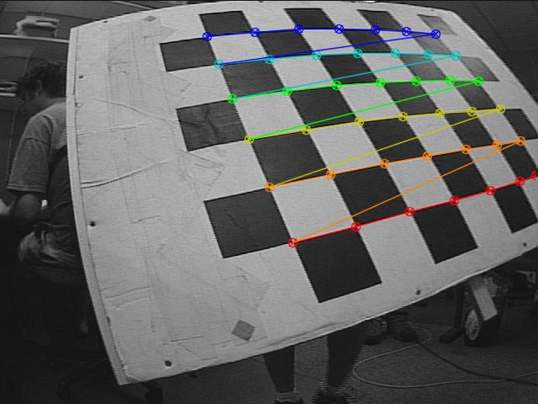
Finding Corners

Slide 6
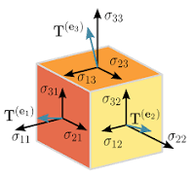
What is a tensor?
a mathematical object analogous to but more general than a vector, represented by an array of components that are functions of the coordinates of a space

